Slide 1

COMPUTER NETWORKS
TEAM NETWORKS
Department of Computer Science and Engineering

Slide 2
COMPUTER NETWORKS
Unit – 4 Network Layer and Internet Protocol
4.1 Overview of Network Layer
4.2 What’s Inside a Router?
4.3 Switching
4.4 The Internet Protocol (IP)
Datagram format
Fragmentation
IPv4 addressing
NAT

Slide 3
COMPUTER NETWORKS
Unit – 4 Network Layer and Internet Protocol
4.1 Overview of Network Layer
4.2 What’s Inside a Router?
4.3 Switching
4.4 The Internet Protocol (IP)
Datagram format
Fragmentation
IPv4 addressing
NAT

Slide 4








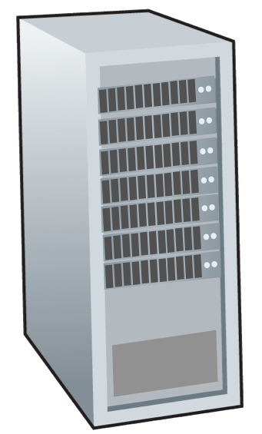







COMPUTER NETWORKS
Network-layer Services and Protocol
transport segment from sending to receiving host
sender: encapsulates segments into datagrams, passes to link layer
receiver: delivers segments to transport layer protocol
network layer protocols in every Internet device: hosts, routers
routers:
examines header fields in all IP datagrams passing through it
moves datagrams from input ports to output ports to transfer datagrams along end-end path
mobile network
national or global ISP
application
transport
network
link
physical
network
link
physical
network
link
physical
network
link
physical
network
link
physical
network
link
physical
datacenter
network
application
transport
network
link
physical
enterprise
network

Slide 5
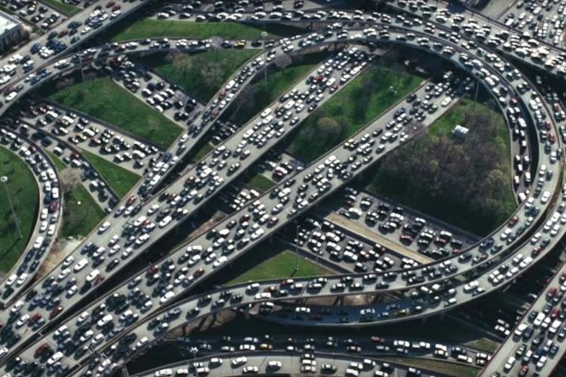
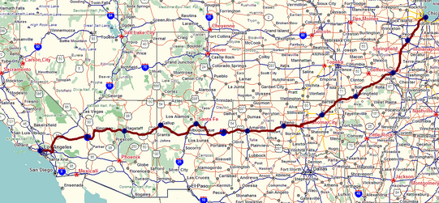
COMPUTER NETWORKS
Two Key Network-layer Functions
network-layer functions:
forwarding: move packets from a router’s input link to appropriate router output link
analogy: taking a trip
forwarding: process of getting through single interchange
routing: process of planning trip from source to destination
routing: determine route taken by packets from source to destination
routing algorithms
forwarding
routing

Slide 6
COMPUTER NETWORKS
Interplay between Routing and Forwarding
routing algorithm
routing algorithm determines
end-end-path through network
forwarding table determines
local forwarding at this router
local forwarding table
header value
output link
0100
0101
0111
1001
3
2
2
1
value in arriving
packet’s header
0111
1
3
2

Slide 7
COMPUTER NETWORKS
Connection Setup
3rd important function in some network architectures:
ATM, frame relay, X.25
before datagrams flow, two end hosts and intervening routers establish virtual connection
routers get involved
network vs transport layer connection service:
network: between two hosts (may also involve intervening routers in case of VCs)
transport: between two processes

Slide 8
COMPUTER NETWORKS
Network Service Model
Q: What service model for “channel” transporting datagrams from sender to receiver?
example services for individual datagrams:
guaranteed delivery
guaranteed delivery with less than 40 msec delay
example services for a flow of datagrams:
in-order datagram delivery
guaranteed minimum bandwidth to flow
restrictions on changes in inter-packet spacing

Slide 9
COMPUTER NETWORKS
Network-layer Service Model
Quality of Service (QoS) Guarantees?
Network
Architecture
Internet
ATM
ATM
Internet
Internet
Service
Model
best effort
Constant Bit Rate
Available Bit Rate
Intserv Guaranteed
(RFC 1633)
Diffserv (RFC 2475)
Bandwidth
none
Constant rate
Guaranteed min
yes
possible
Loss
no
yes
no
yes
possibly
Order
no
yes
yes
yes
possibly
Timing
no
yes
no
yes
no
Internet “best effort” service model
No guarantees on:
successful datagram delivery to destination
timing or order of delivery
bandwidth available to end-end flow

Slide 10
COMPUTER NETWORKS
Network-layer Service Model
Quality of Service (QoS) Guarantees ?
Network
Architecture
Internet
ATM
ATM
Internet
Internet
Service
Model
best effort
Constant Bit Rate
Available Bit Rate
Intserv Guaranteed
(RFC 1633)
Diffserv (RFC 2475)
Bandwidth
none
Constant rate
Guaranteed min
yes
possible
Loss
no
yes
no
yes
possibly
Order
no
yes
yes
yes
possibly
Timing
no
yes
no
yes
no

Slide 11
COMPUTER NETWORKS
Unit – 4 Network Layer and Internet Protocol
4.1 Overview of Network Layer
4.2 What’s Inside a Router?
4.3 Switching
4.4 The Internet Protocol (IP)
Datagram format
Fragmentation
IPv4 addressing
NAT

Slide 12
COMPUTER NETWORKS
Router Architecture Overview
high-level view of generic router architecture:
routing, management
control plane (software)
operates in millisecond
time frame
routing
processor
forwarding data plane (hardware) operates in nanosecond timeframe
high-speed
switching
fabric
router input ports
router output ports

Slide 13
COMPUTER NETWORKS
Input port functions
lookup,
forwarding
queueing
line
termination
link
layer
protocol
(receive)
switch
fabric
physical layer:
bit-level reception
decentralized switching:
using header field values, lookup output port using forwarding table in input port memory (“match plus action”)
goal: complete input port processing at ‘line speed’
input port queuing: if datagrams arrive faster than forwarding rate into switch fabric
link layer:
e.g., Ethernet
(chapter 6)

Slide 14
COMPUTER NETWORKS
Input port functions
lookup,
forwarding
queueing
line
termination
link
layer
protocol
(receive)
switch
fabric
physical layer:
bit-level reception
decentralized switching:
using header field values, lookup output port using forwarding table in input port memory (“match plus action”)
destination-based forwarding: forward based only on destination IP address (traditional)
generalized forwarding: forward based on any set of header field values
link layer:
e.g., Ethernet
(chapter 6)

Slide 15
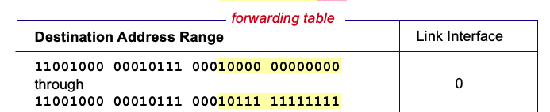

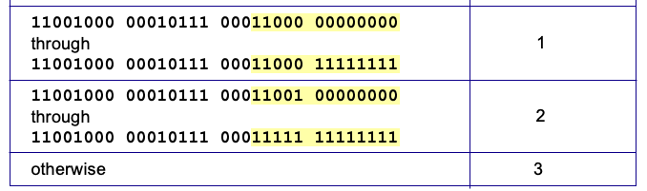
COMPUTER NETWORKS
Destination-based Forwarding
3
Q: but what happens if ranges don’t divide up so nicely?

Slide 16
COMPUTER NETWORKS
Longest prefix matching
longest prefix match
when looking for forwarding table entry for given destination address, use longest address prefix that matches destination address.
Destination Address Range
11001000 00010111 00010
11001000 00010111 00011000
11001000 00010111 00011
otherwise
Link interface
0
1
2
3
***
********
********
***
********
11001000 00010111 00010110 10100001
which interface?
examples:
11001000 00010111 00011000 10101010
which interface?

Slide 17
COMPUTER NETWORKS
Longest prefix matching
longest prefix match
when looking for forwarding table entry for given destination address, use longest address prefix that matches destination address.
Destination Address Range
11001000 00010111 00010
11001000 00010111 00011000
11001000 00010111 00011
otherwise
Link interface
0
1
2
3
***
********
********
match!
***
********
examples:
11001000 00010111 00010110 10100001
which interface?
11001000 00010111 00011000 10101010
which interface?

Slide 18
COMPUTER NETWORKS
Longest prefix matching
longest prefix match
when looking for forwarding table entry for given destination address, use longest address prefix that matches destination address.
Destination Address Range
11001000 00010111 00010
11001000 00010111 00011000
11001000 00010111 00011
otherwise
Link interface
0
1
2
3
***
********
********
***
********
match!
examples:
11001000 00010111 00010110 10100001
which interface?
11001000 00010111 00011000 10101010
which interface?

Slide 19
COMPUTER NETWORKS
Longest prefix matching
longest prefix match
when looking for forwarding table entry for given destination address, use longest address prefix that matches destination address.
Destination Address Range
11001000 00010111 00010
11001000 00010111 00011000
11001000 00010111 00011
otherwise
Link interface
0
1
2
3
***
********
********
***
********
match!
examples:
11001000 00010111 00010110 10100001
which interface?
11001000 00010111 00011000 10101010
which interface?

Slide 20
COMPUTER NETWORKS
Longest prefix matching
we’ll see why longest prefix matching is used shortly, when we study addressing
longest prefix matching: often performed using ternary content addressable memories (TCAMs)
content addressable: present address to TCAM: retrieve address in one clock cycle, regardless of table size
Cisco Catalyst: ~1M routing table entries in TCAM

Slide 21
COMPUTER NETWORKS
Switching Fabrics
switching rate: rate at which packets can be transfer from inputs to outputs
often measured as multiple of input/output line rate
N inputs: switching rate N times line rate desirable
R
(rate: NR, ideally)
R
. . .
high-speed
switching
fabric
. . .
N input ports
N output ports
R
R

Slide 22
COMPUTER NETWORKS
Switching Fabrics
transfer packet from input link to appropriate output link
switching rate: rate at which packets can be transfer from inputs to outputs
often measured as multiple of input/output line rate
N inputs: switching rate N times line rate desirable
three major types of switching fabrics:
memory
memory
bus
interconnection
network

Slide 23
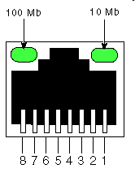
COMPUTER NETWORKS
Switching via Memory
first generation routers:
traditional computers with switching under direct control of CPU
packet copied to system’s memory
speed limited by memory bandwidth (2 bus crossings per datagram)
input
port
(e.g.,
Ethernet)
output
port
(e.g.,
Ethernet)
memory
system bus

Slide 24

COMPUTER NETWORKS
Switching via a Bus
datagram from input port memory to output port memory via a shared bus
bus contention: switching speed limited by bus bandwidth
32 Gbps bus, Cisco 5600: sufficient speed for access routers

Slide 25
COMPUTER NETWORKS
Switching via interconnection network
Crossbar, Clos networks, other interconnection nets initially developed to connect processors in multiprocessor
multistage switch: nxn switch from multiple stages of smaller switches
3x3 crossbar
3x3 crossbar
exploiting parallelism:
fragment datagram into fixed length cells on entry
switch cells through the fabric, reassemble datagram at exit
8x8 multistage switch
built from smaller-sized switches

Slide 26
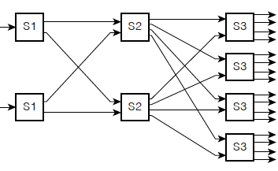
COMPUTER NETWORKS
Switching via interconnection network
scaling, using multiple switching “planes” in parallel:
speedup, scaleup via parallelism
Cisco CRS router:
basic unit: 8 switching planes
each plane: 3-stage interconnection network
up to 100’s Tbps switching capacity
fabric plane 0
fabric plane 1
. . .
. . .
fabric plane 2
. . .
. . .
fabric plane 3
. . .
. . .
fabric plane 4
. . .
. . .
fabric plane 5
. . .
. . .
fabric plane 6
. . .
. . .
fabric plane 7
. . .
. . .
. . .
. . .

Slide 27
COMPUTER NETWORKS
Input port queuing
If switch fabric slower than input ports combined -> queueing may occur at input queues
queueing delay and loss due to input buffer overflow!
Head-of-the-Line (HOL) blocking: queued datagram at front of queue prevents others in queue from moving forward
switch
fabric
switch
fabric
output port contention: only one red datagram can be transferred. lower red packet is blocked
one packet time later: green packet experiences HOL blocking

Slide 28

COMPUTER NETWORKS
Output port queuing
This is a really important slide
datagram
buffer
queueing
switch
fabric
(rate: NR)
link
layer
protocol
(send)
line
termination
R
Buffering required when datagrams arrive from fabric faster than link transmission rate. Drop policy: which datagrams to drop if no free buffers?
Datagrams can be lost due to congestion, lack of buffers
Priority scheduling – who gets best performance, network neutrality
Scheduling discipline chooses among queued datagrams for transmission

Slide 29
COMPUTER NETWORKS
Output port queuing
switch
fabric
switch
fabric
at t, packets more
from input to output
one packet time later
buffering when arrival rate via switch exceeds output line speed
queueing (delay) and loss due to output port buffer overflow!

Slide 30
COMPUTER NETWORKS
How much buffering?
RFC 3439 rule of thumb: average buffering equal to “typical” RTT (say 250 msec) times link capacity C
e.g., C = 10 Gbps link: 2.5 Gbit buffer
more recent recommendation: with N flows, buffering equal to
.
RTT C
N
but too much buffering can increase delays (particularly in home routers)
long RTTs: poor performance for realtime apps, sluggish TCP response
recall delay-based congestion control: “keep bottleneck link just full enough (busy) but no fuller”

Slide 31
COMPUTER NETWORKS
Buffer Management
buffer management:
drop: which packet to add, drop when buffers are full
tail drop: drop arriving packet
priority: drop/remove on priority basis
datagram
buffer
queueing
scheduling
switch
fabric
link
layer
protocol
(send)
line
termination
R
Abstraction: queue
marking: which packets to mark to signal congestion (ECN, RED)
R
packet
departures
packet
arrivals
queue
(waiting area)
link
(server)

Slide 32
COMPUTER NETWORKS
Unit – 4 Network Layer and Internet Protocol
4.1 Overview of Network Layer
4.2 What’s Inside a Router?
4.3 Switching
4.4 The Internet Protocol (IP)
Datagram format
Fragmentation
IPv4 addressing
NAT
4.5 Introduction to Network Layer Protocols
DHCP
ICMP
4.6 IPv6 Addressing
4.7 Introduction to Routing Algorithms

Slide 33
COMPUTER NETWORKS
Network Layer: Internet
host, router network layer functions:
transport layer: TCP, UDP
IP protocol
datagram format
addressing
packet handling conventions
Path-selection algorithms: implemented in
routing protocols (OSPF, BGP)
SDN controller
network
layer
forwarding
table
ICMP protocol
error reporting
router “signaling”
link layer
physical layer

Slide 34
COMPUTER NETWORKS
IP Datagram Format
32 bits
IP protocol version number
head.
len
type of
service
total datagram
length (bytes)
ver
length
header length(bytes)
“type” of service:
diffserv (0:5)
ECN (6:7)
flgs
fragment
offset
fragmentation/
reassembly
16-bit identifier
time to
live
upper
layer
header
checksum
header checksum
TTL: remaining max hops
(decremented at each router)
source IP address
32-bit source IP address
destination IP address
Maximum length: 64K bytes
Typically: 1500 bytes or less
upper layer protocol (e.g., TCP or UDP)
32-bit destination IP address
overhead
options (if any)
e.g., timestamp, record route taken
20 bytes of TCP
20 bytes of IP
= 40 bytes + app layer overhead for TCP+IP
payload data
(variable length,
typically a TCP
or UDP segment)

Slide 35
COMPUTER NETWORKS
Unit – 4 Network Layer and Internet Protocol
4.1 Overview of Network Layer
4.2 What’s Inside a Router?
4.3 Switching
4.4 The Internet Protocol (IP)
Datagram format
Fragmentation
IPv4 addressing
NAT
4.5 Introduction to Network Layer Protocols
DHCP
ICMP
4.6 IPv6 Addressing
4.7 Introduction to Routing Algorithms

Slide 36

COMPUTER NETWORKS
IP fragmentation, reassembly
network links have MTU (max.transfer size) - largest possible link-level frame
different link types, different MTUs
large IP datagram divided (“fragmented”) within net
one datagram becomes several datagrams
“reassembled” only at final destination
IP header bits used to identify, order related fragments
…
fragmentation:
in: one large datagram
out: 3 smaller datagrams
reassembly
…

Slide 37
COMPUTER NETWORKS
IP fragmentation, reassembly
length
=4000
ID
=x
fragflag
=0
offset
=0
example:
4000 byte datagram
MTU = 1500 bytes
one large datagram becomes
several smaller datagrams
1480 bytes in data field
length
=1500
ID
=x
fragflag
=1
offset
=0
offset =
1480/8
length
=1500
ID
=x
fragflag
=1
offset
=185
length
=1040
ID
=x
fragflag
=0
offset
=370

Slide 38
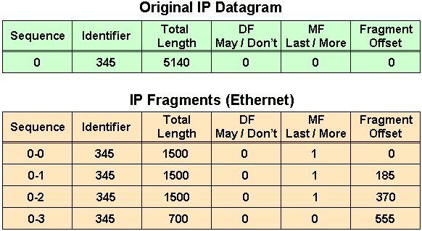
COMPUTER NETWORKS
Fragmentation – Example

Slide 39

COMPUTER NETWORKS
Fragmentation – Numerical Example
An IP router with a Maximum Transmission Unit (MTU) of 200 bytes has received an IP packet of size 520 bytes with an IP header of length 20 bytes. The values of the relevant fields in the IP header.

Slide 40
COMPUTER NETWORKS
Unit – 4 Network Layer and Internet Protocol
4.1 Overview of Network Layer
4.2 What’s Inside a Router?
4.3 Switching
4.4 The Internet Protocol (IP)
Datagram format
Fragmentation
IPv4 addressing
NAT
4.5 Introduction to Network Layer Protocols
DHCP
ICMP
4.6 IPv6 Addressing
4.7 Introduction to Routing Algorithms

Slide 41
COMPUTER NETWORKS
IP addressing: Introduction
223.1.1.1
IP address: 32-bit unique ID associated with each host or router interface
interface: connection between host/router and physical link
router’s typically have multiple interfaces
host typically has one or two interfaces (e.g., wired Ethernet, wireless 802.11)
223.1.2.1
223.1.1.2
223.1.1.4
223.1.2.9
223.1.1.3
223.1.3.27
223.1.2.2
223.1.3.1
223.1.3.2
dotted-decimal IP address notation:
223.1.1.1 = 11011111 00000001 00000001 00000001
223
1
1
1

Slide 42
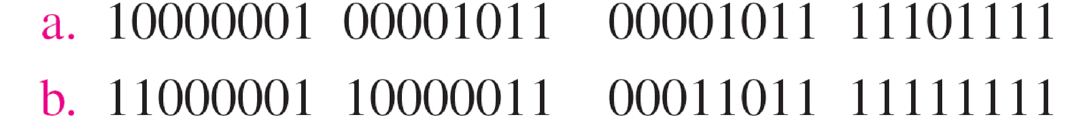
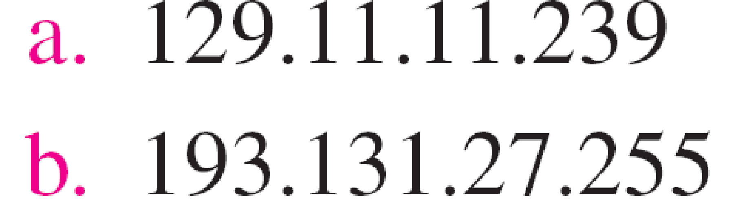
COMPUTER NETWORKS
IP addressing: Introduction
Change the following IPv4 addresses from binary notation to dotted-decimal notation.
Solution:
We replace each group of 8 bits with its equivalent decimal number and add dots for separation.

Slide 43
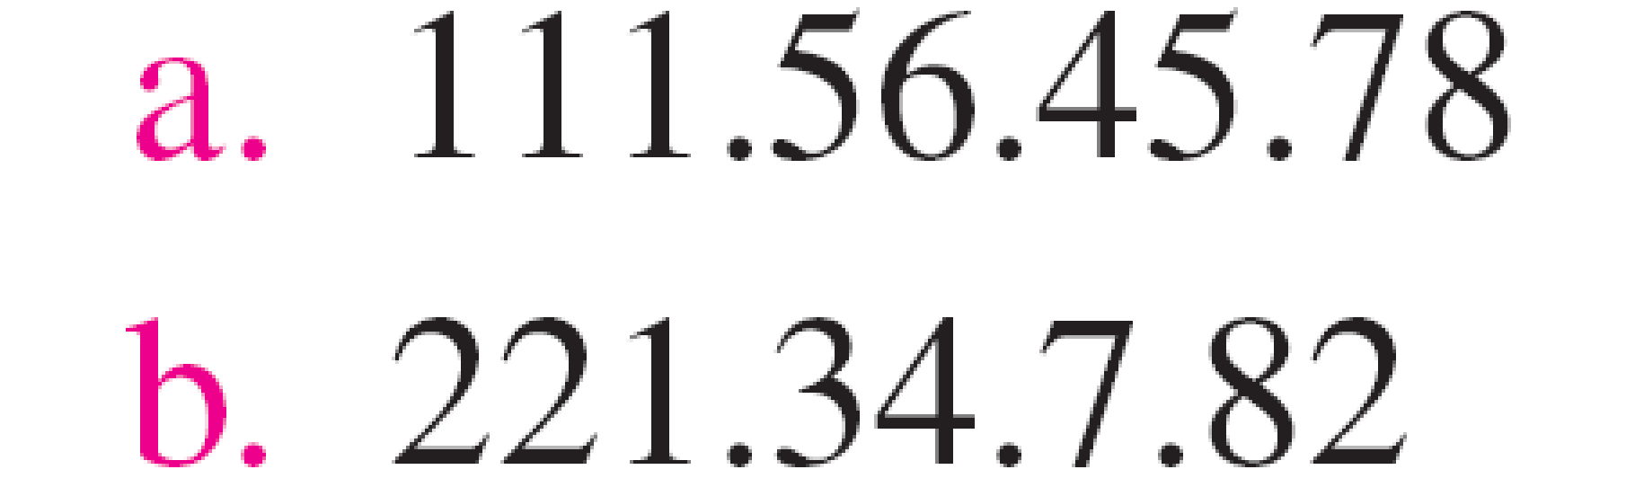
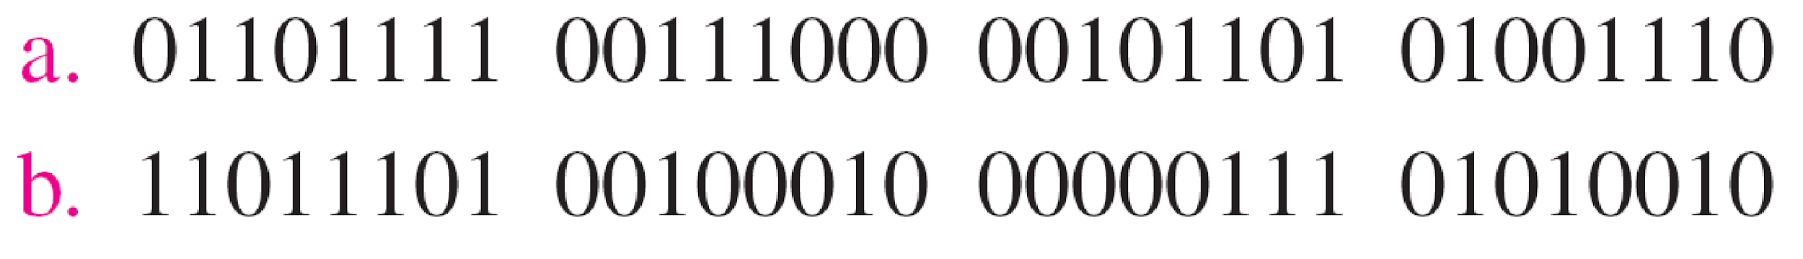
COMPUTER NETWORKS
IP addressing: Introduction
Change the following IPv4 addresses from dotted-decimal notation to binary notation.
Solution:
We replace each decimal number with its binary equivalent.

Slide 44
COMPUTER NETWORKS
IP addressing: Introduction
223.1.1.1
Q: how are interfaces actually connected?
223.1.2.1
223.1.1.2
A: we’ll learn about that in chapters 6, 7
A: wired
Ethernet interfaces connected by Ethernet switches
223.1.1.4
223.1.2.9
223.1.1.3
223.1.3.27
223.1.2.2
For now: don’t need to worry about how one interface is connected to another (with no intervening router)
223.1.3.1
223.1.3.2
A: wireless WiFi interfaces connected by WiFi base station

Slide 45
COMPUTER NETWORKS
Subnets
What’s a subnet ?
device interfaces that can physically reach each other without passing through an intervening router
223.1.1.1
223.1.2.1
223.1.1.2
223.1.1.4
223.1.2.9
223.1.1.3
223.1.3.27
223.1.2.2
IP addresses have structure:
subnet part: devices in same subnet have common high order bits
host part: remaining low order bits
223.1.3.1
223.1.3.2
network consisting of 3 subnets
A portion of a network that shares a particular subnet address.

Slide 46
COMPUTER NETWORKS
Subnets
subnet 223.1.1.0/24
Recipe for defining subnets:
detach each interface from its host or router, creating “islands” of isolated networks
each isolated network is called a subnet
223.1.1.1
subnet 223.1.2.0/24
223.1.2.1
223.1.1.2
223.1.1.4
223.1.2.9
223.1.1.3
223.1.3.27
223.1.2.2
subnet
223.1.3.0/24
223.1.3.1
223.1.3.2
subnet mask: /24
(high-order 24 bits: subnet part of IP address)

Slide 47
COMPUTER NETWORKS
Subnets
223.1.1.2
subnet 223.1.1/24
where are the subnets?
what are the /24 subnet addresses?
223.1.1.1
223.1.1.4
223.1.1.3
223.1.9.2
223.1.7.0
subnet 223.1.7/24
subnet 223.1.9/24
223.1.9.1
223.1.7.1
223.1.8.1
223.1.8.0
subnet 223.1.2/24
223.1.2.6
subnet 223.1.8/24
223.1.3.27
A 32-bit combination used to describe which portion of an address refers to the subnet and which part refers to the host.
subnet 223.1.3/24
223.1.2.1
223.1.2.2
223.1.3.1
223.1.3.2

Slide 48
COMPUTER NETWORKS
IP addressing: CIDR
CIDR: Classless InterDomain Routing (pronounced “cider”)
subnet portion of address of arbitrary length
address format: a.b.c.d/x, where x is # bits in subnet portion of address
subnet
part
host
part
11001000 00010111 00010000 00000000
200.23.16.0/23

Slide 49
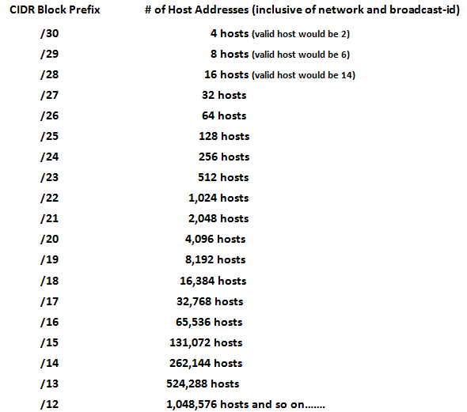
COMPUTER NETWORKS
IP addressing: CIDR

Slide 50

COMPUTER NETWORKS
IP addressing: Why not Classful Addressing?
Network portion - 8, 16, or 24 bits in length – known as Class A, B and C networks respectively
A class C (/24) - accommodate only up to 2⁸ - 2 = 254 hosts (two of the 2⁸ = 256 addresses are reserved for special use)
A class B (/16) subnet, supports up to 65,634 hosts
A class A (/8) subnet, up to 16,777,214 hosts
too small for many organizations
too large, poor utilization
Classful addressing, which is almost obsolete, is replaced with classless addressing.

Slide 51
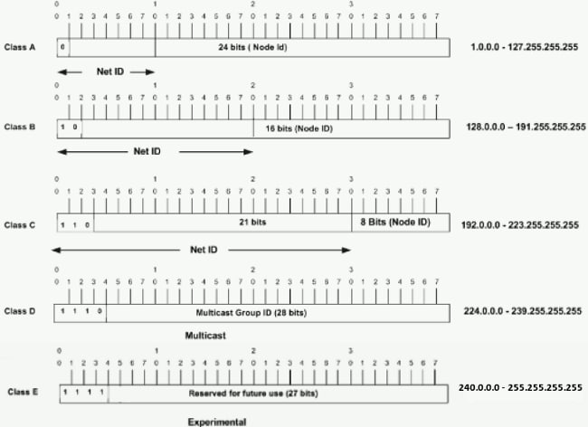
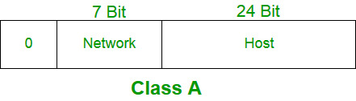
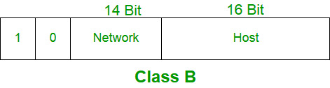
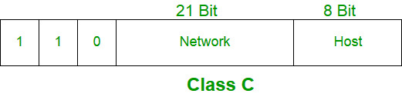
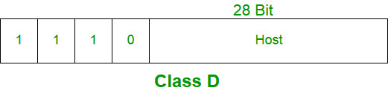
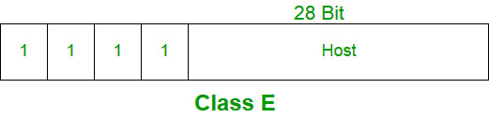
COMPUTER NETWORKS
IP addressing: Classful Addressing

Slide 52
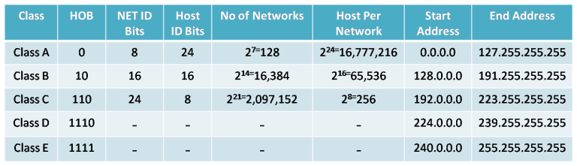
COMPUTER NETWORKS
IP addressing: Classful Addressing
Class D: multicast, Class E: reserved (experimental)
Network Masks
Class A: 255.0.0.0
Class B: 255.255.0.0
Class C: 255.255.255.0
Broadcast Address: 255.255.255.255

Slide 53
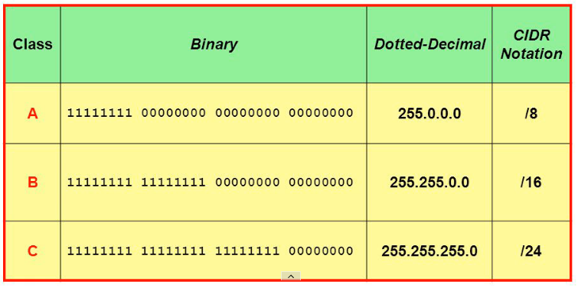
COMPUTER NETWORKS
IP addressing: Classful Subnet Masks

Slide 54
COMPUTER NETWORKS
IP addresses: how to get one?
Q: how does network get subnet part of IP address?
A: gets allocated portion of its provider ISP’s address space
ISP's block 11001000 00010111 00010000 00000000 200.23.16.0/20
ISP can then allocate out its address space in 8 blocks:
Organization 0 11001000 00010111 00010000 00000000 200.23.16.0/23
Organization 1 11001000 00010111 00010010 00000000 200.23.18.0/23
Organization 2 11001000 00010111 00010100 00000000 200.23.20.0/23
... ….. …. ….
Organization 7 11001000 00010111 00011110 00000000 200.23.30.0/23

Slide 55
COMPUTER NETWORKS
IP addressing: introduction
Find the class of each address.
a. 00000001 00001011 00001011 11101111
b. 11000001 10000011 00011011 11111111
c. 14.23.120.8
d. 252.5.15.111
Solution
a. The first bit is 0. This is a class A address.
b. The first 2 bits are 1; the third bit is 0. This is a class C address.
c. The first byte is 14; the class is A.
d. The first byte is 252; the class is E.

Slide 56
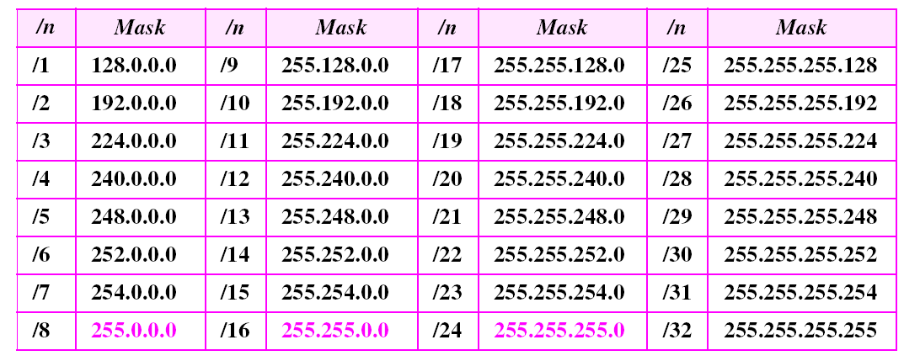
COMPUTER NETWORKS
IP addressing: CIDR – Prefix Lengths
The addresses in color are the default masks for classes A, B, and C.
Thus, classful addressing is a special case of classless addressing.

Slide 57
COMPUTER NETWORKS
Hierarchical addressing: route aggregation
Organization 1
hierarchical addressing allows efficient advertisement of routing information:
Organization 0
200.23.16.0/23
200.23.18.0/23
“Send me anything
with addresses
beginning
200.23.16.0/20”
The ability to use a single prefix to advertise multiple networks is often referred to as address aggregation (also route aggregation or route summarization).
Organization 2
200.23.20.0/23
.
Fly-By-Night-ISP
.
.
.
.
Internet
Organization 7
.
200.23.30.0/23
ISPs-R-Us
“Send me anything
with addresses
beginning
199.31.0.0/16”

Slide 58
COMPUTER NETWORKS
Hierarchical addressing: more specific routes
Organization 1 moves from Fly-By-Night-ISP to ISPs-R-Us
ISPs-R-Us now advertises a more specific route to Organization 1
Organization 0
200.23.16.0/23
Organization 1
200.23.18.0/23
“Send me anything
with addresses
beginning
200.23.16.0/20”
Organization 2
200.23.20.0/23
.
Fly-By-Night-ISP
.
.
.
.
Internet
Organization 7
.
200.23.30.0/23
ISPs-R-Us
“Send me anything
with addresses
beginning
199.31.0.0/16”
Organization 1
200.23.18.0/23
“or 200.23.18.0/23”

Slide 59
COMPUTER NETWORKS
Hierarchical addressing: more specific routes
Organization 1 moves from Fly-By-Night-ISP to ISPs-R-Us
ISPs-R-Us now advertises a more specific route to Organization 1
Organization 0
200.23.16.0/23
“Send me anything
with addresses
beginning
200.23.16.0/20”
Organization 2
200.23.20.0/23
.
Fly-By-Night-ISP
.
.
.
.
Internet
Organization 7
.
200.23.30.0/23
ISPs-R-Us
“Send me anything
with addresses
beginning
199.31.0.0/16”
Organization 1
200.23.18.0/23
“or 200.23.18.0/23”

Slide 60
COMPUTER NETWORKS
IP addresses: how to get one?
That’s actually two questions:
Q: How does a host get IP address within its network (host part of address)?
Q: How does a network get IP address for itself (network part of address)
How does host get IP address?
hard-coded by sysadmin in config file (e.g., /etc/rc.config in UNIX)
DHCP: Dynamic Host Configuration Protocol: dynamically get address from as server
“plug-and-play”

Slide 61
COMPUTER NETWORKS
Unit – 4 Network Layer and Internet Protocol
4.1 Overview of Network Layer
4.2 What’s Inside a Router?
4.3 Switching
4.4 The Internet Protocol (IP)
Datagram format
Fragmentation
IPv4 addressing
NAT
4.5 Introduction to Network Layer Protocols
DHCP
ICMP
4.6 IPv6 Addressing
4.7 Introduction to Routing Algorithms

Slide 62
COMPUTER NETWORKS
DHCP: Dynamic Host Configuration Protocol
goal: host dynamically obtains IP address from network server when it “joins” network
can renew its lease on address in use
allows reuse of addresses (only hold address while connected/on)
support for mobile users who join/leave network
DHCP overview:
host broadcasts DHCP discover msg [optional]
DHCP server responds with DHCP offer msg [optional]
host requests IP address: DHCP request msg
DHCP server sends address: DHCP ack msg

Slide 63
COMPUTER NETWORKS
DHCP client-server scenario
Typically, DHCP server will be co-located in router, serving all subnets to which router is attached
DHCP server
223.1.1.1
223.1.2.1
223.1.2.5
223.1.1.2
223.1.1.4
223.1.2.9
223.1.1.3
223.1.3.27
arriving DHCP client needs
address in this network
223.1.2.2
223.1.3.1
223.1.3.2

Slide 64


COMPUTER NETWORKS
DHCP client-server scenario
DHCP server: 223.1.2.5
DHCP discover
Arriving client
src : 0.0.0.0, 68
dest.: 255.255.255.255,67
yiaddr: 0.0.0.0
transaction ID: 654
Broadcast: is there a DHCP server out there?
DHCP offer
src: 223.1.2.5, 67
dest: 255.255.255.255, 68
yiaddrr: 223.1.2.4
transaction ID: 654
lifetime: 3600 secs
Broadcast: I’m a DHCP server! Here’s an IP address you can use
The two steps above can be skipped “if a client remembers and wishes to reuse a previously allocated network address” [RFC 2131]
DHCP request
src: 0.0.0.0, 68
dest:: 255.255.255.255, 67
yiaddrr: 223.1.2.4
transaction ID: 655
lifetime: 3600 secs
Broadcast: OK. I would like to use this IP address!
DHCP ACK
src: 223.1.2.5, 67
dest: 255.255.255.255, 68
yiaddrr: 223.1.2.4
transaction ID: 655
lifetime: 3600 secs
Broadcast: OK. You’ve got that IP address!

Slide 65
COMPUTER NETWORKS
DHCP: more than IP addresses
DHCP can return more than just allocated IP address on subnet:
address of first-hop router for client
name and IP address of DNS sever
network mask (indicating network versus host portion of address)

Slide 66


COMPUTER NETWORKS
DHCP: example
DHCP
DHCP
UDP
IP
Eth
Phy
Connecting laptop will use DHCP to get IP address, address of first-hop router, address of DNS server.
DHCP
DHCP
DHCP
DHCP
DHCP REQUEST message encapsulated in UDP, encapsulated in IP, encapsulated in Ethernet
DHCP
DHCP
UDP
IP
Eth
Phy
168.1.1.1
DHCP
DHCP
DHCP
Ethernet frame broadcast (dest: FFFFFFFFFFFF) on LAN, received at router running DHCP server
DHCP
router with DHCP
server built into
router
Ethernet demux’ed to IP demux’ed, UDP demux’ed to DHCP

Slide 67
COMPUTER NETWORKS
DHCP: example
DHCP
UDP
IP
Eth
Phy
DCP server formulates DHCP ACK containing client’s IP address, IP address of first-hop router for client, name & IP address of DNS server
DHCP
DHCP
DHCP
DHCP
encapsulated DHCP server reply forwarded to client, demuxing up to DHCP at client
DHCP
DHCP
UDP
IP
Eth
Phy
DHCP
DHCP
DHCP
router with DHCP
server built into
router
client now knows its IP address, name and IP address of DNS server, IP address of its first-hop router
DHCP

Slide 68
COMPUTER NETWORKS
IP addressing: last words…
Q: how does an ISP get block of addresses?
A: ICANN: Internet Corporation for Assigned Names and Numbers http://www.icann.org/
allocates IP addresses, through 5 regional registries (RRs) (who may then allocate to local registries)
manages DNS root zone, including delegation of individual TLD (.com, .edu, …) management
Q: are there enough 32-bit IP addresses?
ICANN allocated last chunk of IPv4 addresses to RRs in 2011
NAT (next) helps IPv4 address space exhaustion
IPv6 has 128-bit address space
"Who the hell knew how much address space we needed?" Vint Cerf (reflecting on decision to make IPv4 address 32 bits long)

Slide 69
COMPUTER NETWORKS
Unit – 4 Network Layer and Internet Protocol
4.1 Overview of Network Layer
4.2 What’s Inside a Router?
4.3 Switching
4.4 The Internet Protocol (IP)
Datagram format
Fragmentation
IPv4 addressing
NAT
4.5 Introduction to Network Layer Protocols
DHCP
ICMP
4.6 IPv6 Addressing
4.7 Introduction to Routing Algorithms

Slide 70
COMPUTER NETWORKS
NAT: Network Address Translation
all devices in local network have 32-bit addresses in a “private” IP address space (10/8, 172.16/12, 192.168/16 prefixes) that can only be used in local network
advantages:
just one IP address needed from provider ISP for all devices
can change addresses of host in local network without notifying outside world
can change ISP without changing addresses of devices in local network
security: devices inside local net not directly addressable, visible by outside world

Slide 71
COMPUTER NETWORKS
NAT: Network Address Translation
NAT: all devices in local network share just one IPv4 address as far as outside world is concerned
rest of
Internet
local network (e.g., home network) 10.0.0/24
10.0.0.1
138.76.29.7
10.0.0.4
10.0.0.2
10.0.0.3
all datagrams leaving local network have same source NAT IP address: 138.76.29.7, but different source port numbers
datagrams with source or destination in this network have 10.0.0/24 address for source, destination (as usual)

Slide 72
COMPUTER NETWORKS
NAT: Network Address Translation
implementation: NAT router must (transparently):
outgoing datagrams: replace (source IP address, port #) of every outgoing datagram to (NAT IP address, new port #)
remote clients/servers will respond using (NAT IP address, new port #) as destination address
remember (in NAT translation table) every (source IP address, port #) to (NAT IP address, new port #) translation pair
incoming datagrams: replace (NAT IP address, new port #) in destination fields of every incoming datagram with corresponding (source IP address, port #) stored in NAT table

Slide 73
COMPUTER NETWORKS
NAT: Network Address Translation
NAT translation table
WAN side addr LAN side addr
2: NAT router changes datagram source address from 10.0.0.1, 3345 to 138.76.29.7, 5001,
updates table
1: host 10.0.0.1 sends datagram to 128.119.40.186, 80
138.76.29.7, 5001 10.0.0.1, 3345
…… ……
S: 10.0.0.1, 3345
D: 128.119.40.186, 80
10.0.0.1
1
2
S: 138.76.29.7, 5001
D: 128.119.40.186, 80
10.0.0.4
10.0.0.2
138.76.29.7
S: 128.119.40.186, 80
D: 10.0.0.1, 3345
4
S: 128.119.40.186, 80
D: 138.76.29.7, 5001
3
10.0.0.3
3: reply arrives, destination address: 138.76.29.7, 5001

Slide 74
COMPUTER NETWORKS
NAT: Network Address Translation
NAT has been controversial:
routers “should” only process up to layer 3
address “shortage” should be solved by IPv6
violates end-to-end argument (port # manipulation by network-layer device)
NAT traversal: what if client wants to connect to server behind NAT?
but NAT is here to stay:
extensively used in home and institutional nets, 4G/5G cellular nets

Slide 75
COMPUTER NETWORKS
NAT: Network Address Translation
10.0.0.1
client
Solution: statically configure NAT to forward incoming connection requests at given port to server
e.g., (123.76.29.7, port 25000) always forwarded to 10.0.0.1 port 25000
?
10.0.0.4
138.76.29.7
NAT
router

